Slide 1











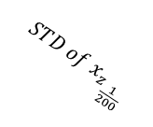


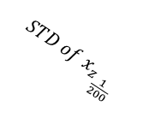


$$Effect Size comparison$$
$$Reach$$
$$Keyboard$$
$$Reach area$$
$$AUC$$
$$Reaction time$$
$$Movement time$$
$$Num of COM$$
$$Total traveled distance$$
$$MAD$$
$$Deviation$$
$$RT$$
$$STD of x$$
$$deviatio{n of x}_{z_{\frac{1}{200}}}$$
$$deviatio{n of x}_{z_{\frac{200}{200}}}$$
$${STD of x}_{z_{\frac{1}{200}}}$$
$${STD of x}_{z_{\frac{1}{200}}}$$

